Slide 1


How Do Position Encodings Affect Length Generalization?
Case Studies on In-Context Function Learning
位置編碼如何影響長度泛化性？基於上下文函數學習的案例研究
Author:
Di-Nan Lin（林諦南）
Advisor:
Prof. Hung-Yu Kao（高宏宇教授）
National Cheng Kung University
Department of Computer Science and Information Engineering
Intelligent Knowledge Management Laboratory

Slide 2
Outline
Introduction
Background
Motivation
Related Work
Length Generalizaiton
Position Encodings
In-Context Learning
Methodology
Experiments
Analysis
Recency Bias
Inductive Bias
Serial-Position Effect
Conclusion
Notes:
每個 Task 中各 PEs 的優缺點要背一下

Slide 3
Introduction
Backgroud
LLM fails on long context.
Motivation
Memorization Capacity
Our Work

Slide 4
LLM is unpredictable
Introduction ー Background
Prompt Engineering = In-Context Learning (ICL)
Prompt Engineering has become a daily work for people nowadays.
LLM A
We get a good response from this prompt
Prompt
LLM B
We get a bad response from this prompt
▲ Figure: Unpredictable behavior for the same prompt.
We cannot definitively ascertain why specific prompts enhance performance
or why the same prompt may yield suboptimal results with another LLM.
Notes:
現在 LLMs 對多數人來說已經是個普遍的日常工具了，如何精準的下 prompt 就變成了一個重要的技巧，這也是為什麼 Prompt Engineering ...
一般而言 Prompt Engineering 也可以稱呼為 ICL，指的是 LLM 要依賴上下文去理解我們的指令。
但 prompt 對 LLM 會對造成什麼樣的效果，其實非常難以預測，...
所以 LLM 的運作機制，我們的掌握度並不高。

Slide 5



LLM also lost in long context
Introduction ー Background
We might have extended conversations on a single topic with an LLM, only to find that it sometimes forgets or overlooks certain details.
How can I help you?
I want to …
Performance Decrease
…
…
…
…
▲ Figure: LLM fails when context get longer.
Notes:
好比說 LLM 在長文本下的行為，...

Slide 6
LLM also lost in long context
Introduction ー Background
We might have extended conversations on a single topic with an LLM, only to find that it sometimes forgets or overlooks certain details.
Our input for LLM
(Liu et al., TACL 2024)
How can I help you?
NICE
Prompt
… context …
I want to …
…
… context …
Prompt
…
…
AWFUL
context
Prompt
context
▲ Figure: LLM fails when context get longer.

Slide 7

Why LLM cannot perform ICL in long context?
Introduction ー Motivation
Intuition
Similar to humans, LLM have a limited memorization capacity.
Model tend to forget because its parameters only sufficient to memorize these info.
Set up an experiment
Train from scratch
Output labels
NER Dataset (CoNLL 2003)
3, 0, 7, 0, 0, 0, 7, 0, 0
Decoder
EU<b-org> rejects<o> German<b-misc> call<o> to<o> boycott<o> British<b-misc> lamb<o> .<o>
→
→
Y₁
Y₂
Y₃
Linear Layer
X₁
Y₁
X₂
Y₂
X₃
…

Slide 8
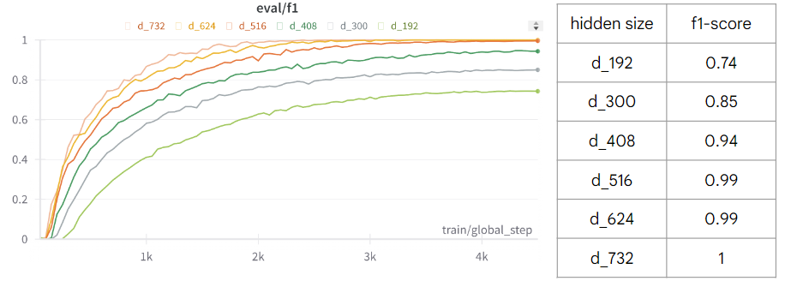
Validating the hypothesis of memorizatoin capacity
Introduction ー Motivation
Dataset
We let
Data avg length | 21.19
Total samples | 1400
Train set
=
Valid set
▲ Figure: Overview of the results. [Thesis p.2]
Notes:
Original dataset.
Avg. length: 21.19
Max length: 83
Tokens length of each sample is 128 or higher except the last one.

Slide 9
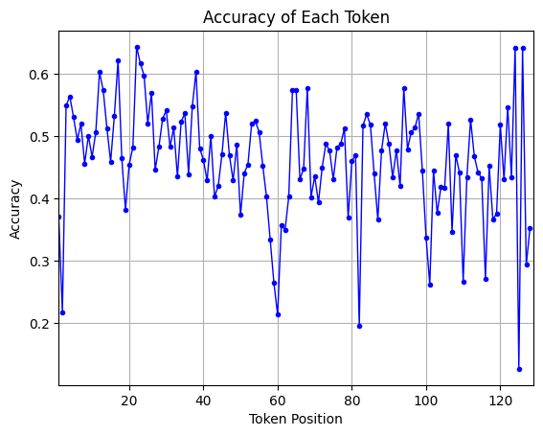
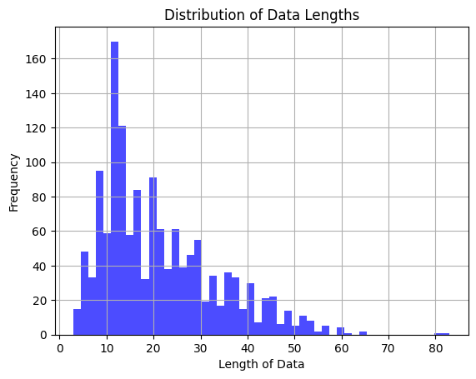
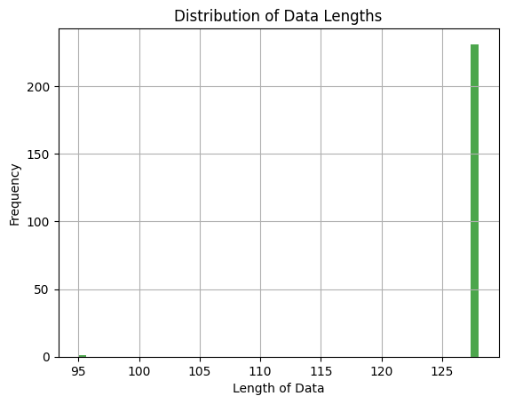
Validating the hypothesis of memorizatoin capacity
Introduction ー Motivation
Dataset
We let
(concat all data)
Data avg length | 21.19
Total samples | 1400
Train set
=
Test set
but has longer length.
Train on
Test on
▲ Train set
▲ Test set
▲ Figure: Results. [Thesis p.3]

Slide 10
What makes the experiment fail?
Introduction ー Motivation
In the NER task, words are not independent, and mutual influence during concatenation may have caused a decline in accuracy.
Training data mainly consists of short sentences. The uneven data length distribution may hurt the model and let some positions underfitting.
Find a dataset without any positional bias (order does not influence results).
The key to achieving length generalization in LLM?
Function Dataset
Position Encodings (PEs)

Slide 11
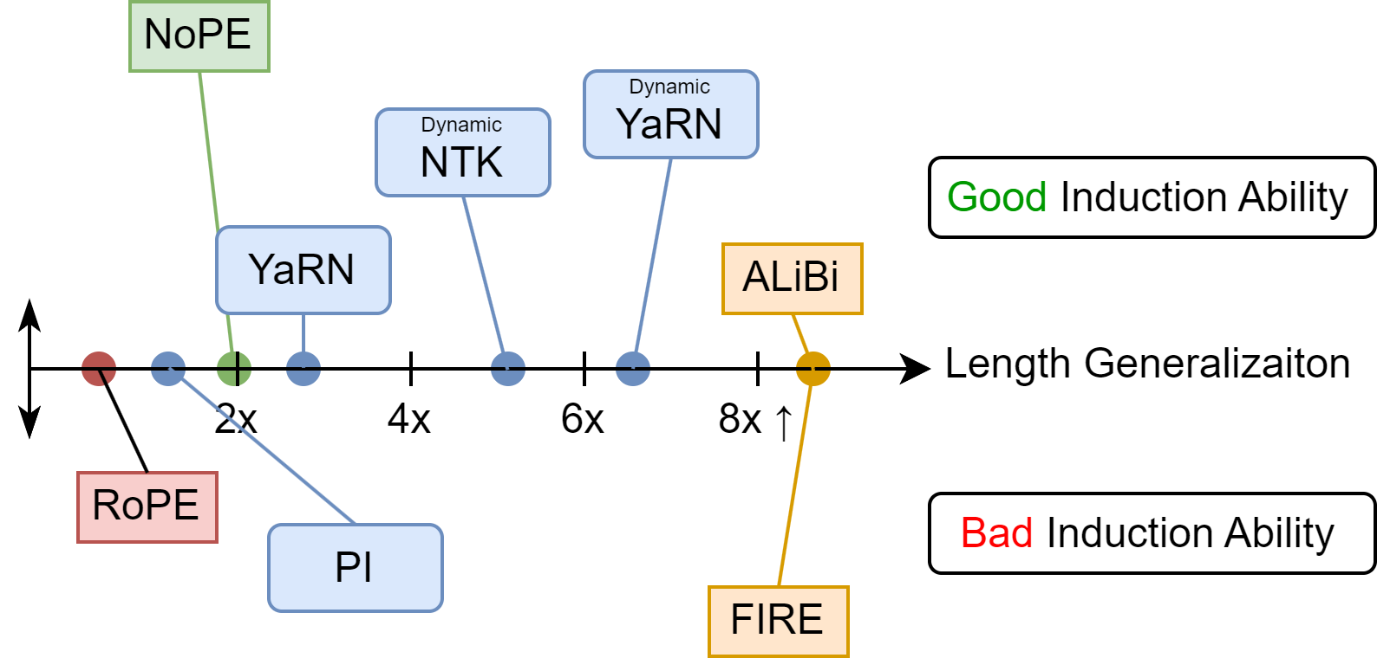
Overall, our contributions are:
Introduction ー Our Work
PEs sustain model’s ICL capability on out-of-distribution (OOD) lengths.
PEs enhance ICL capability across different tasks and increase accuracy.
PEs might reduce Induction Ability, which is a trade-off between length.
Length Generalization:
Model can extrapolate to longer text.
Induction Ability:
Model can utilize induction heads.
▲ Figure: Different performance between PEs. [Thesis p.4]

Slide 12
Related Work
Length Generalization
Computational complexity
Position Encodings
The key to extrapolate
In-Context Learning
Learning to Learn

Slide 13
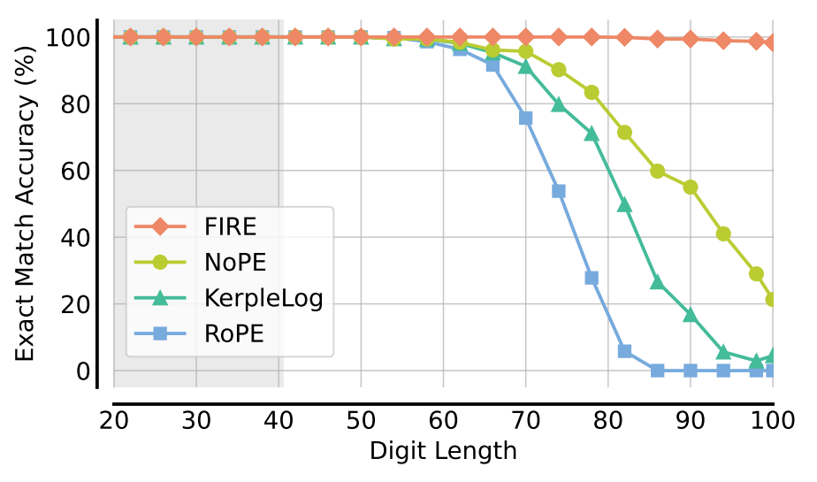
Length Generalization
Related Work ー Length Generalization
14 + 32 → 55
123 + 654 → 777
Goal
Teach (train) model how to add (learn an algorithm).
*Current SoTA can only generalize to lengths 2.5x longer than training set.
Problem
Results
(Zhou et al., ICLR 2024)
Carry operation is not easy:
5678 + 9012 → ?????
The digit length is a challenge
as well.

Slide 14
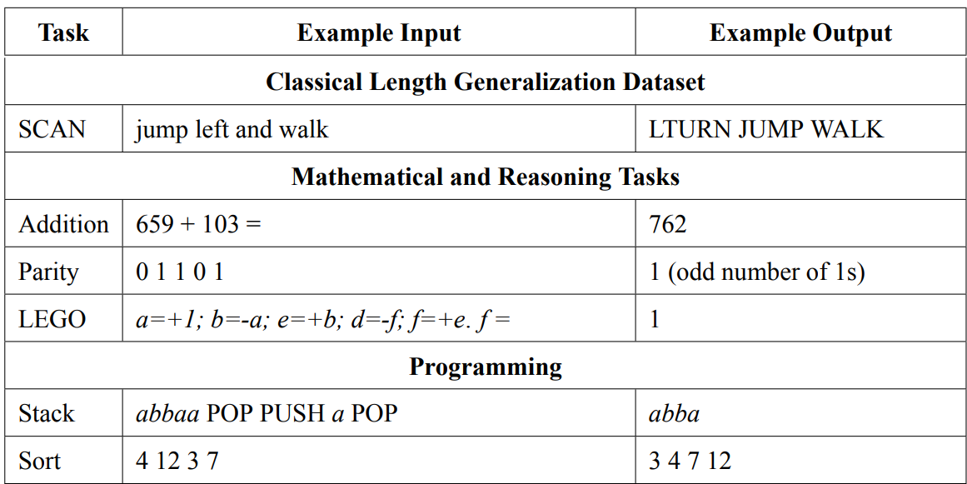
Length Generalization
Related Work ー Length Generalization
▼ Table: Examples of the tasks for length generalization. [Thesis p.6]
Lake et al.,
2018
Anil et al.,
2022
Zhang et al.,
2023
Deletang et al.,
2023

Slide 15
Length Generalization
Related Work ー Length Generalization
▼ Table: Examples of the tasks for length generalization. [Thesis p.6]
Lake et al.,
2018
Anil et al.,
2022
Zhang et al.,
2023
Deletang et al.,
2023

Slide 16
Length Generalization
Related Work ー Length Generalization
▼ Table: Examples of the tasks for length generalization. [Thesis p.6]
Lake et al.,
2018
Anil et al.,
2022
Zhang et al.,
2023
Deletang et al.,
2023

Slide 17
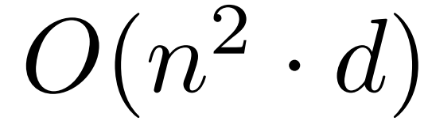
Why Transformer struggles with OOD length?
Related Work ー Length Generalization
You need lots of GPUs to train a long context LLM due to the computational complexity of self-attention is
You use learnable position encoding like what GPT-2 does, and it is impossible to do length generalization.
Data distribution? Architecture constraints? It’s still a research question. But most think the key is Position Encoding.

Slide 18
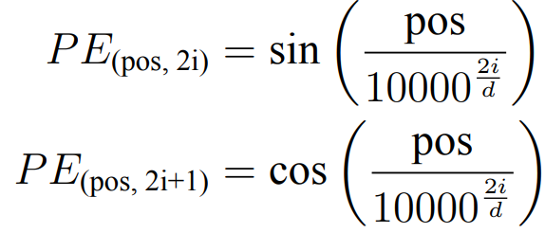
Position Encodings (PEs)
Related Work ー Position Encodings
Absolute Position Encoding (APE):
(Vaswani et al., 2017)
Learnable position encoding (BERT, GPT-2)
Sinusoidal Position Encoding (Vanilla Transformer):
Normalize the range
can keep the value within [-1, 1].
where 2i, 2i+1 is the dimension of the position embedding, d is the model hidden dimension, and 10000 is the wavelengths form a geometric progression.

Slide 19
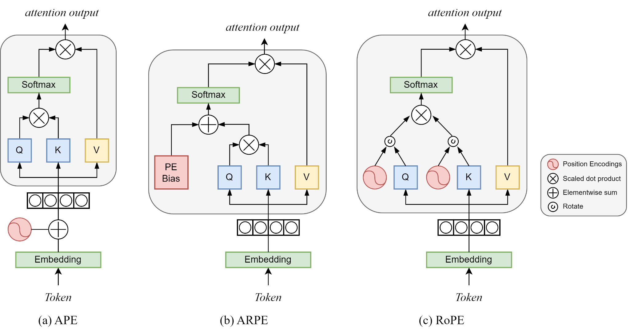
Absolute Position Encoding (APE)
Related Work ー Position Encodings
▲ Figure: Overview of the results. [Thesis p.7]

Slide 20
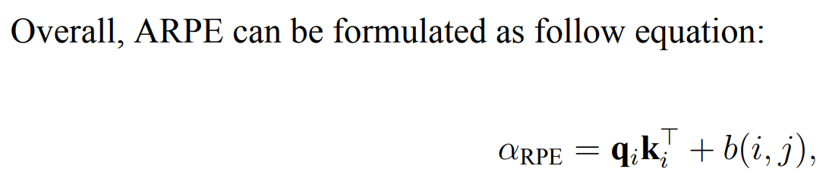
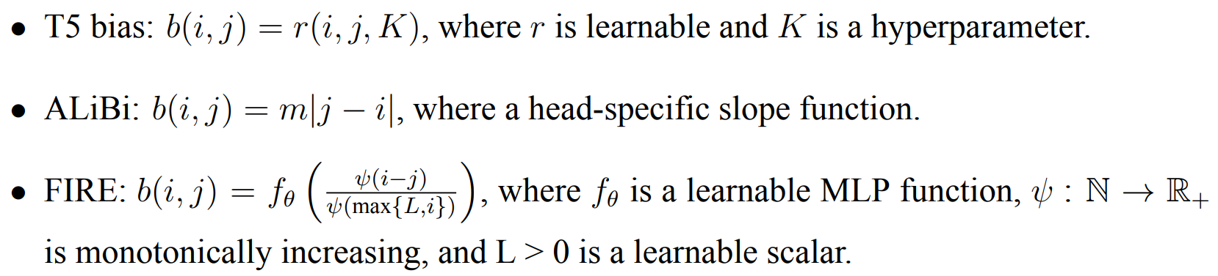
Additive Relative Position Encoding (ARPE)
Related Work ー Position Encodings

Slide 21
Additive Relative Position Encoding (ARPE)
Related Work ー Position Encodings
▲ Figure: Overview of the results. [Thesis p.7]

Slide 22
Rotary Position Encoding (RoPE)
Related Work ー Position Encodings
When token at position m
m
▲ Figure: Overview of the results. [Thesis p.7]

Slide 23
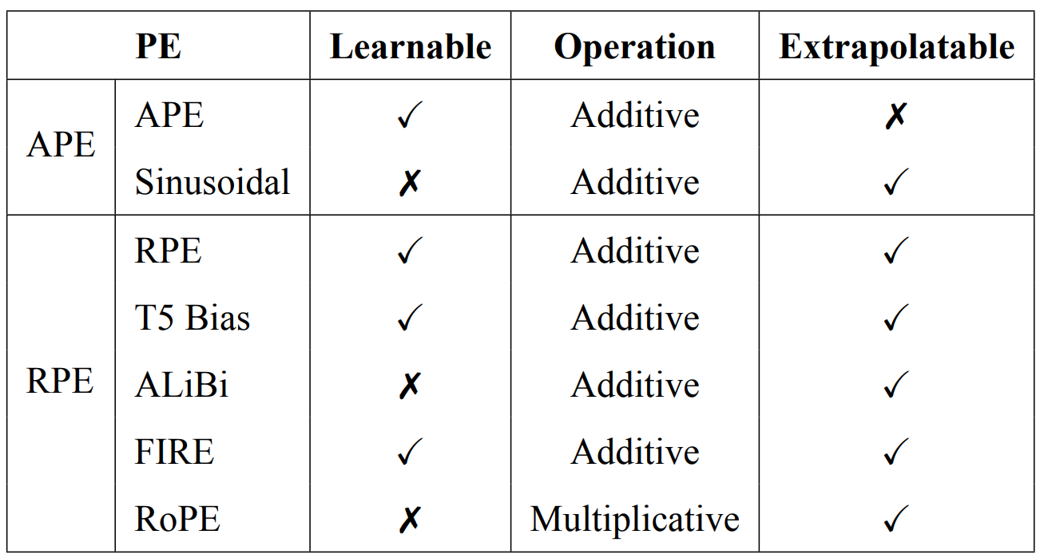
List of PEs
Related Work ー Position Encodings
▼ Table: List of PEs and their differences. [Thesis p.8]
Shaw et al.,
2018
Raffel et al.,
2020
Press et al.,
2022
Li et al.,
2024
Su et al.,
2021

Slide 24
In-Context Learning with Meta Learning
Related Work ー In-Context Learning
1 + 1 = 2 ; 2 + 1 = 3 ; 3 + 2 = 5 ; 4 + 5 = ?

Slide 25
In-Context Learning with Meta Learning
Related Work ー In-Context Learning
1 + 1 = 2 ; 2 + 1 = 3 ; 3 + 2 = 5 ; 4 + 5 = ?
(1 , 1) = 2
(2 , 1) = 3
(3 , 2) = 5
We want model
Learning to learn an algorithm!
(4 , 5) = ?

Slide 26
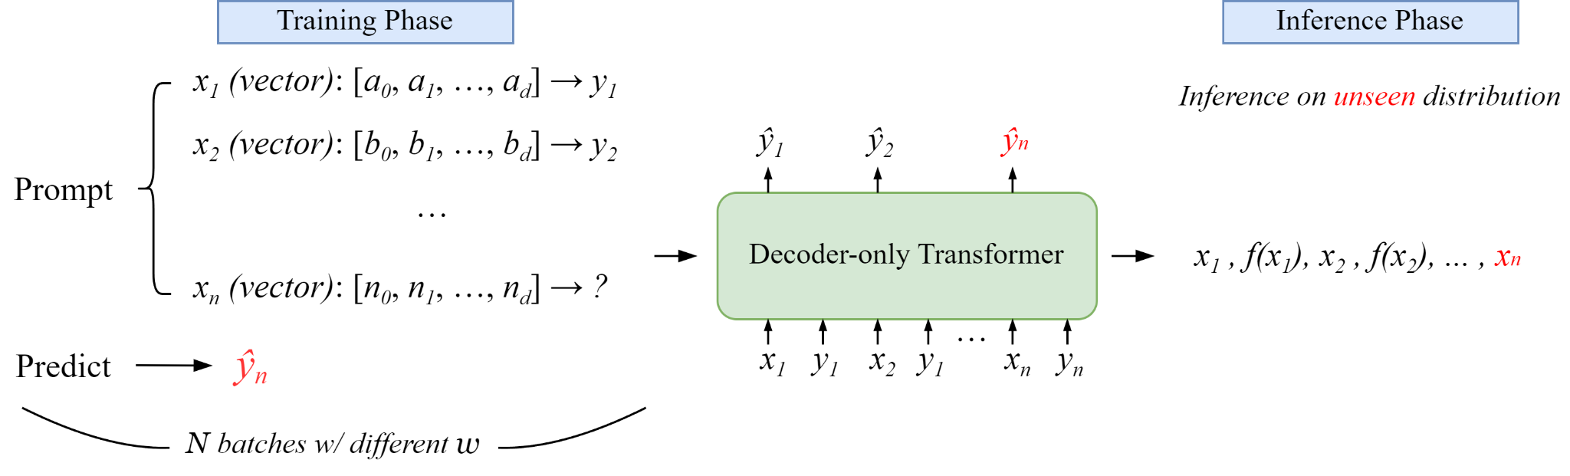
In-Context Meta Learning
Related Work ー In-Context Learning
▲ Figure: Overview of In-Context Meta Learning setup [Thesis p.12]
Learning to learn Linear Regression and Boolean functions
(Garg et al., NIPS 2022)
(Bhattamishra et al., ICLR 2024)

Slide 27
Summary of Related Work
Related Work ー Summary
Length Generalization is hard, but maybe a good
Position Encoding can solve the problem.
To make sure data without any positional bias, we use
In-Context Meta Learning with 2 function classes.

Slide 28
Methodology
Preliminary Experiments
In-Context Meta Learning
Task Description
Regression functions
Boolean functions
Other Setups
Hyperparams & Baseline

Slide 29
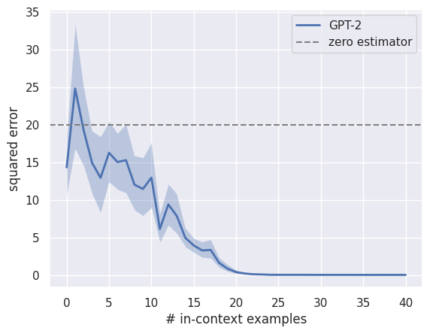
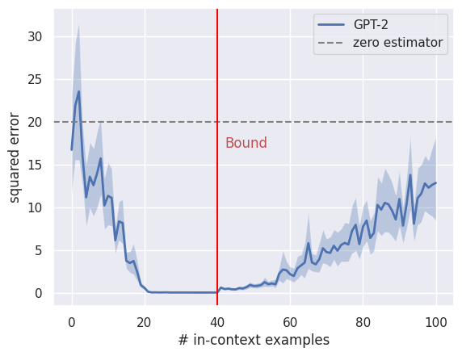
Preliminary: Model fails on OOD Length
Methodology ー Preliminary
We already know that GPT-2 fails because of learnable PE, which is an APE.
▲ Figure: GPT-2 fails on OOD length. [Thesis p.14]

Slide 30
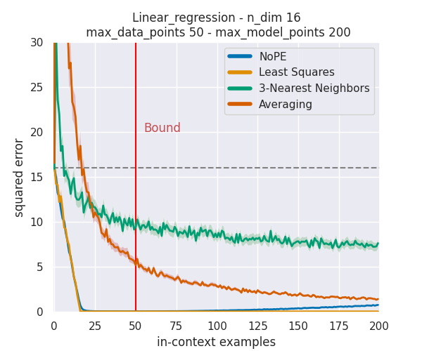
Preliminary: No Position Encoding (NoPE) also fails
Methodology ー Preliminary
Blue line should be completely flat.
But our data is irrelevant to position.
▲ Figure: NoPE is not perfect. [Thesis p.15]

Slide 31
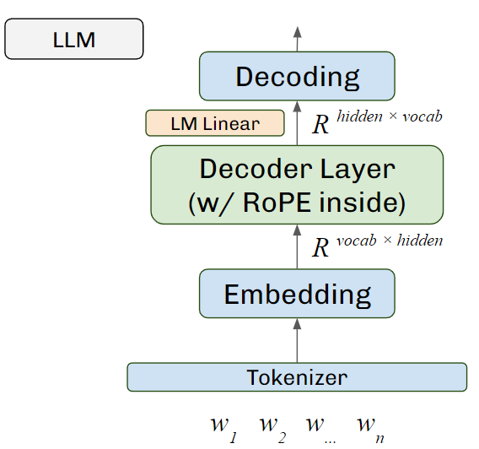
Model Architecture
Methodology ー Preliminary
ICL model
R ^{hidden × y-dim (=1)}
Linear
R ^{hidden}
Decoder Layer × n
R ^{x-dim× hidden}
Linear
▲ Figure: LLMs usually have to tokenize words and generate outputs by decoding.
x₁
x₂
x...
x_{n}

Slide 32
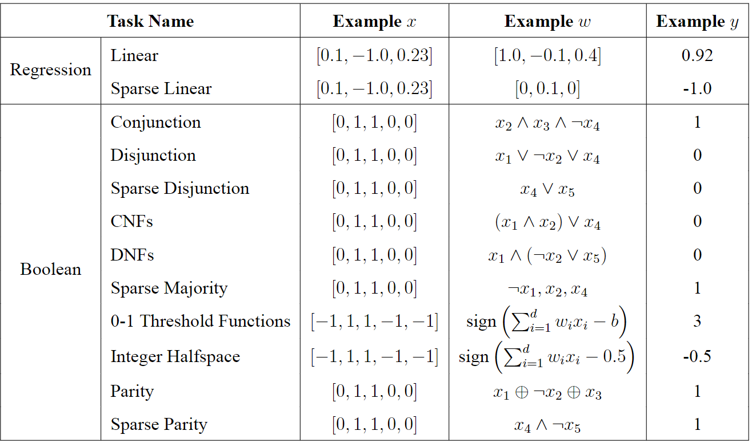
Task Description
Methodology ー Task Description
(Garg et al., NIPS 2022)
(Bhattamishra et al., ICLR 2024)
▼ Table: List of our function classes.
10

Slide 33
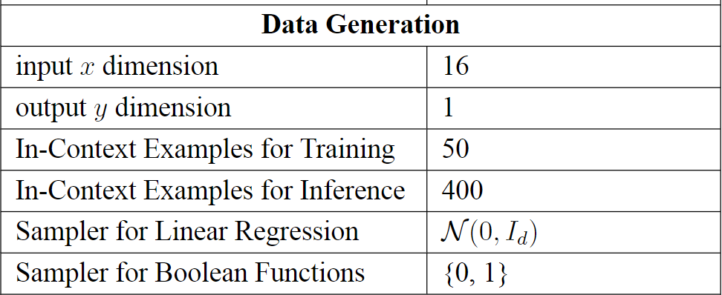
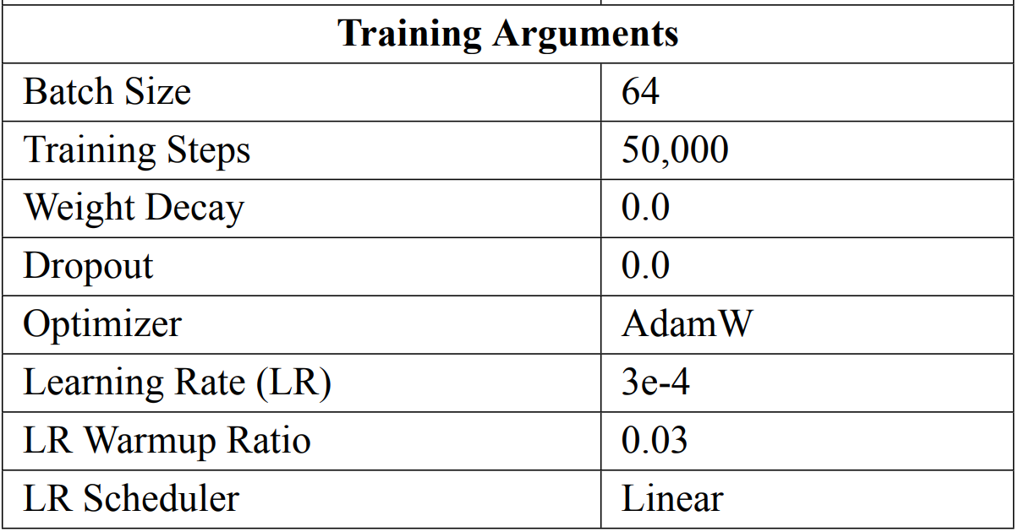
Hyperparameters Settings
Methodology ー Other Setups
▼ Table: Hyperparameters summary [Thesis p.19]

Slide 34
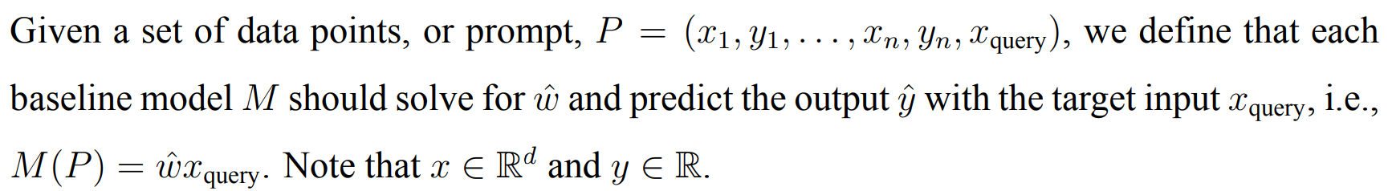
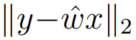
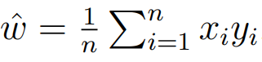
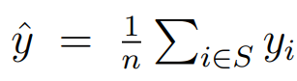
Baseline for Linear Regression
Methodology ー Other Setups
Least squares:
Minimize . This estimator needs d samples to solve ŵ.
Averaging estimator:
This estimator computes .
Nearest neighbors:
This estimator computes , where S is the set of indices of n nearest neighbors. We set n = 3.

Slide 35
Baseline for Boolean Functions
Methodology ー Other Setups
Null classifier:
This estimator will only predict 0 for each input.
Averaging estimator:
Same estimator as in Linear Regression.
Nearest neighbors:
Same estimator as in Linear Regression. For most tasks, we set n = 3, except for Conjunction, Disjunction, and Majority tasks, where we set n = 1.

Slide 36
Summary of Methodology
Methodology ー Summary
We use 8 PEs
NoPE|ALiBi|FIRE|RoPE|PI|Dynamic NTK|YaRN|Dynamic YaRN
Linear Regression|Sparse Linear Regression| Conjunction|Disjunction|Sparse Disjunction| CNFs|DNFs|Sparse Majoriy|0-1 Threshold Functions|Integer Halfspace|Parity|Sparse Parity
And 12 function classes
To see how PEs affect Length Generalization
while ensuring that no other variables influence our experiments.

Slide 37
Experiments
Easy to Memorize
Demonstrate ICL capability
Hard to solve

Slide 38
We categorize the task characteristics into 3 types:
Experiments ー Glossary
Easy to Memorize: Model can answer correctly without needing in-context examples.
Demonstrate ICL capability: Model can learn algorithm from training tasks and predict answers when facing unseen data.
Hard to solve: Model is unable to utilize In-Context Meta Learning to learn and answer.

Slide 39
Experiments ー Glossary
PE (We will focus on it)
Baseline

Slide 40
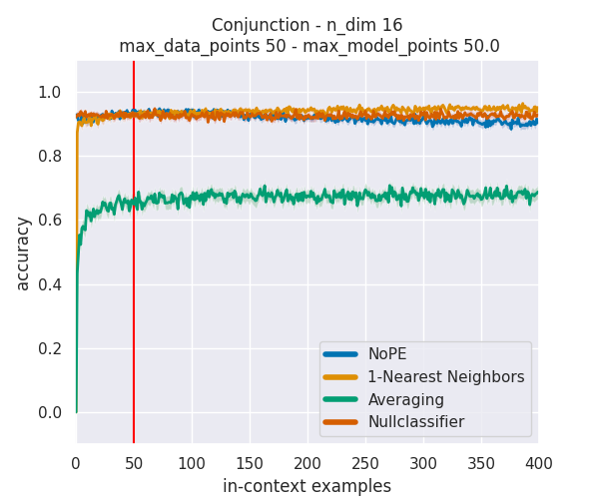
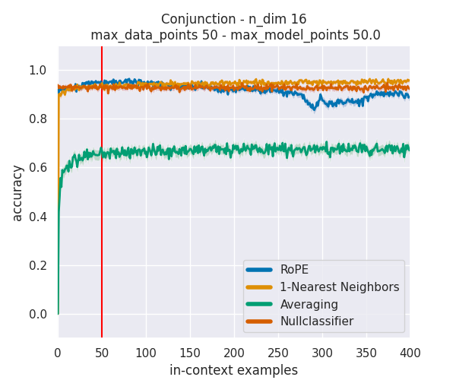
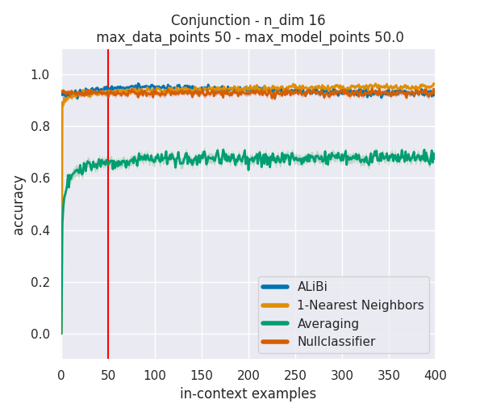
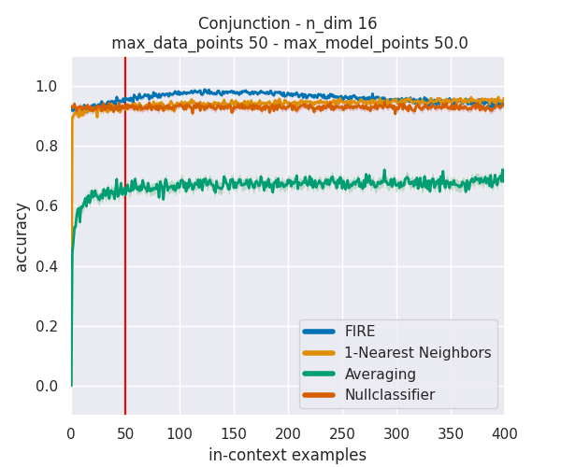
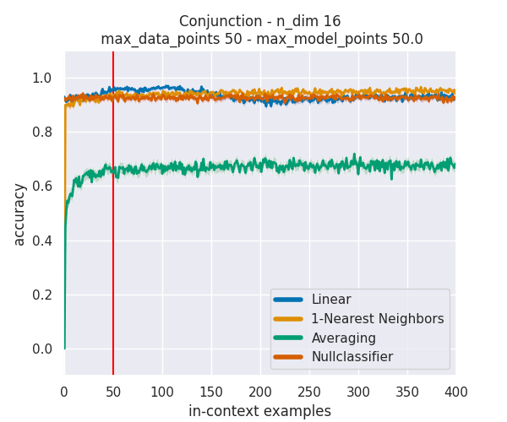
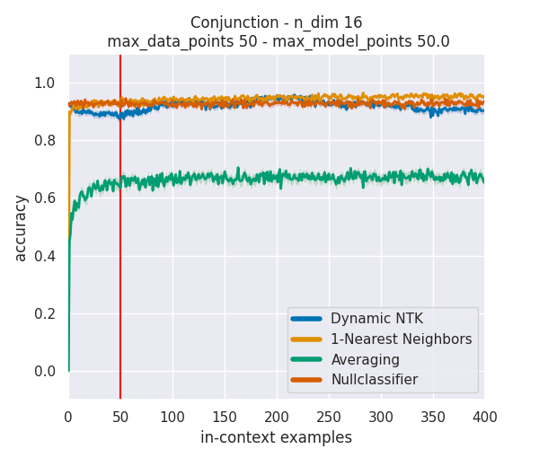

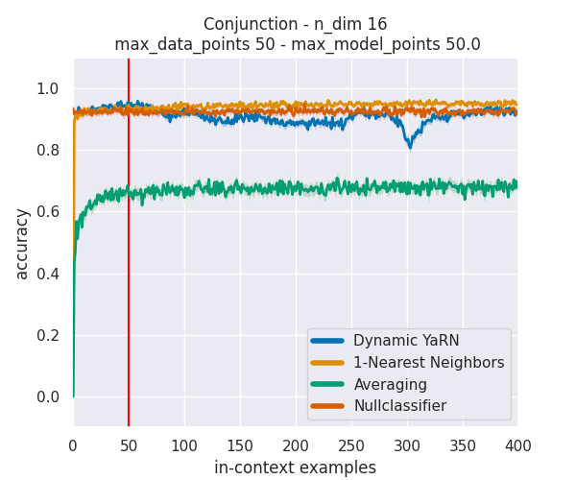
Easy to Memorize: Conjunction
Experiments ー Easy to Memorize
NoPE
RoPE
ALiBi
FIRE
PI (Linear)
Dynamic NTK
YaRN
Dynamic YaRN

Slide 41
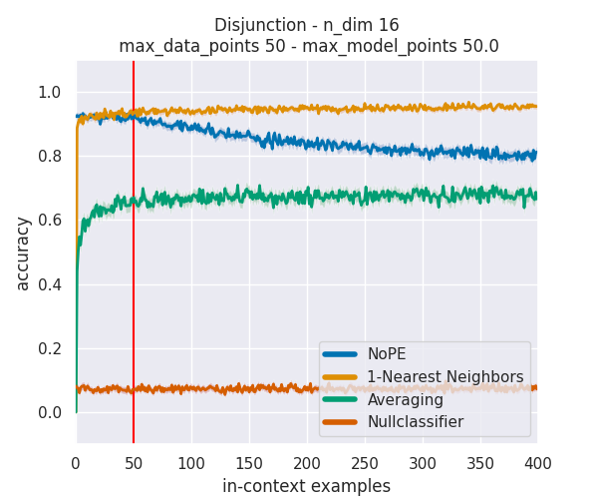
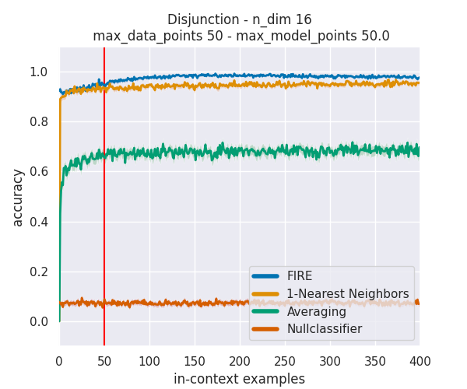
Easy to Memorize: Disjunction
Experiments ー Easy to Memorize
NoPE
FIRE

Slide 42
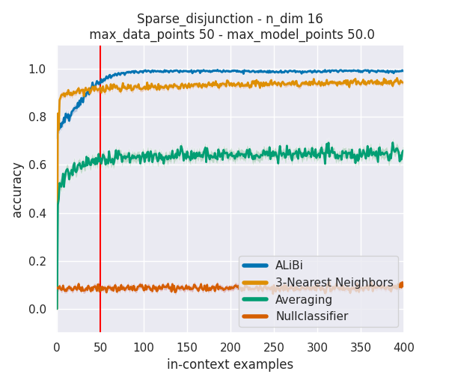
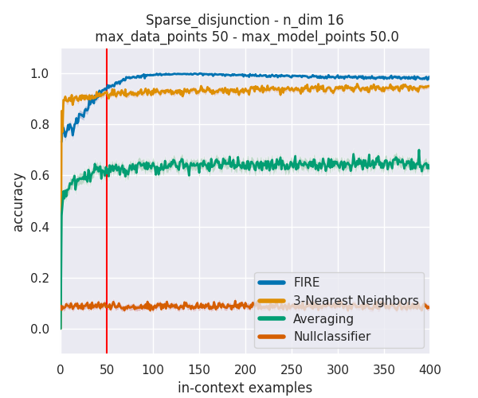
Easy to Memorize: Sparse Disjunction
Experiments ー Easy to Memorize
ALiBi
FIRE

Slide 43
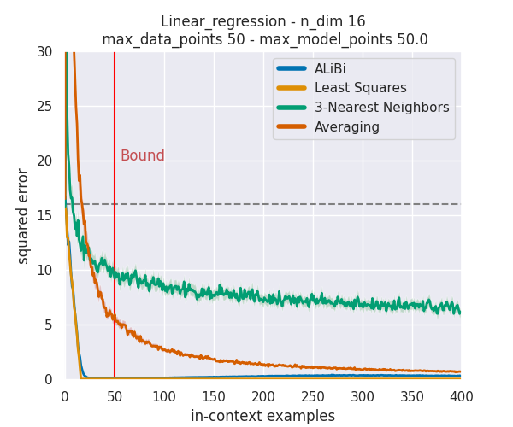
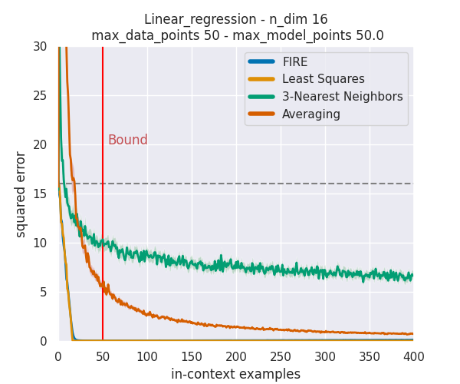
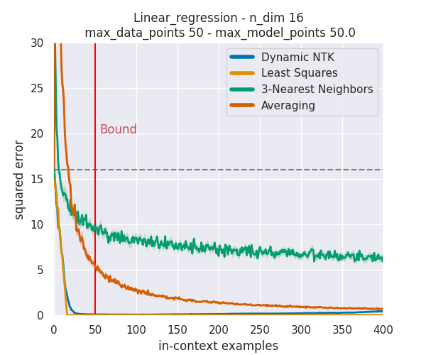
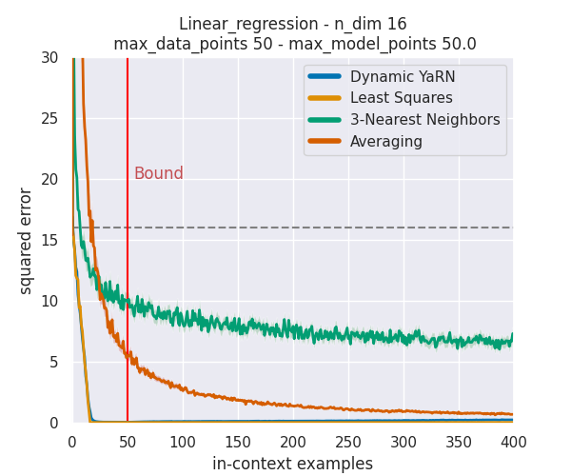
Demonstrate ICL Capability: Linear Regression
Experiments ー Demonstrate ICL Capability
ALiBi
FIRE
Dynamic NTK
Dynamic YaRN

Slide 44
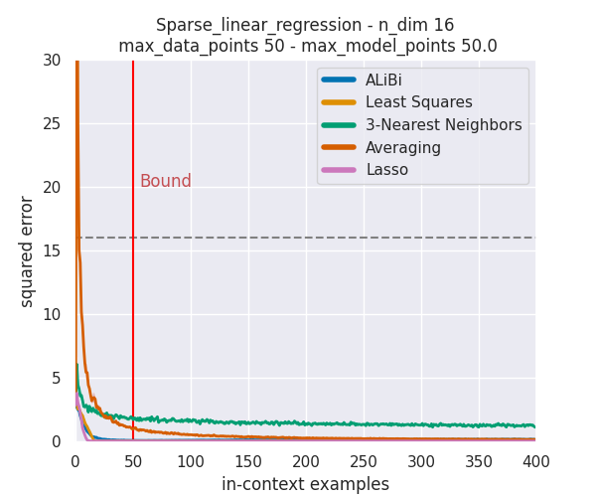
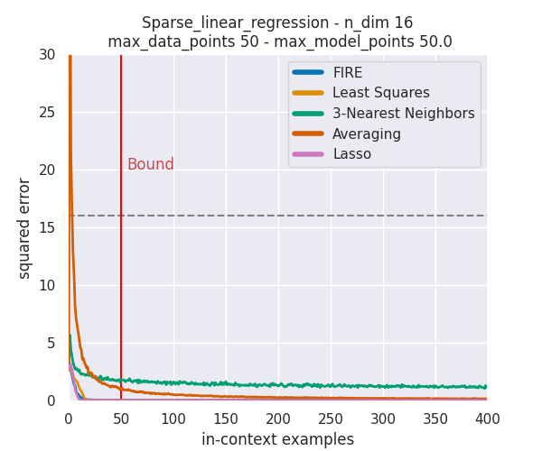
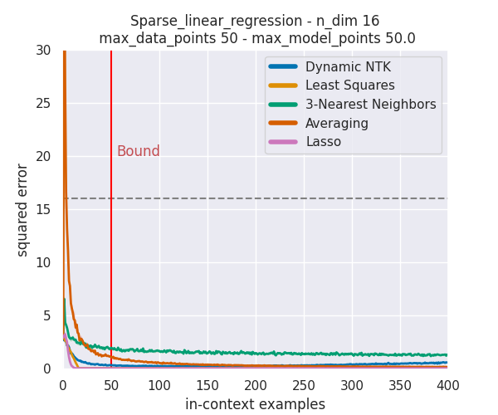
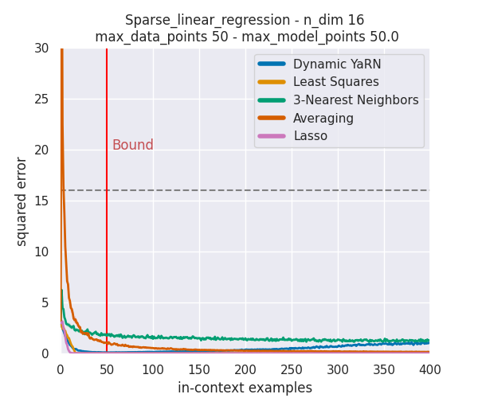
Demonstrate ICL Capability: Sparse Linear Regression
Experiments ー Demonstrate ICL Capability
ALiBi
FIRE
Dynamic NTK
Dynamic YaRN

Slide 45
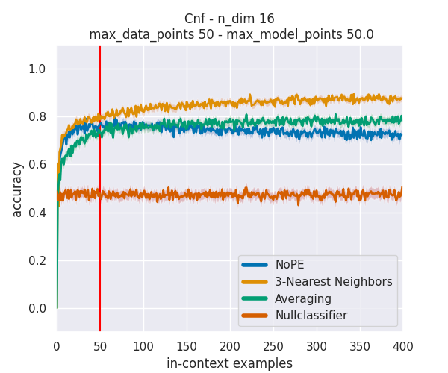
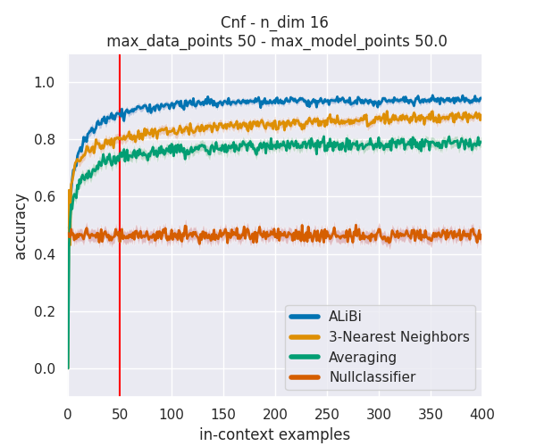
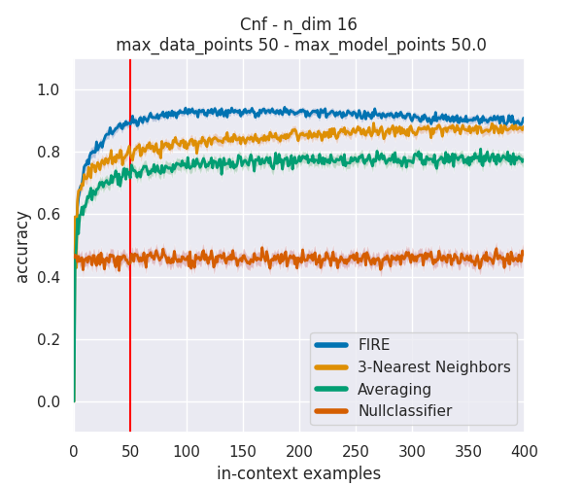
Demonstrate ICL Capability: CNFs
Experiments ー Demonstrate ICL Capability
NoPE
ALiBi
FIRE

Slide 46
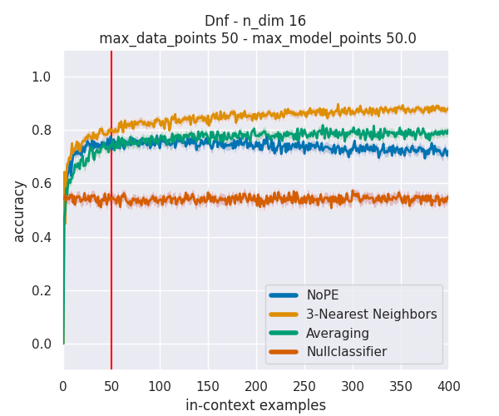
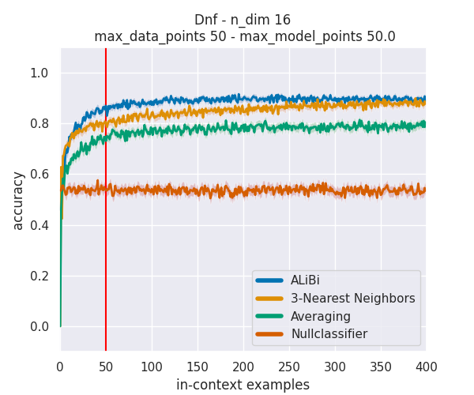
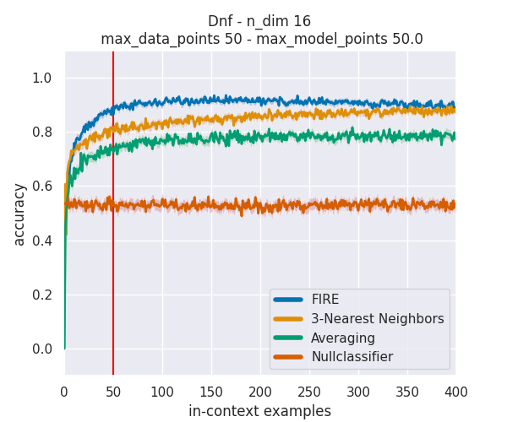
Demonstrate ICL Capability: DNFs
Experiments ー Demonstrate ICL Capability
NoPE
ALiBi
FIRE

Slide 47



Demonstrate ICL Capability: Sparse Majority
Experiments ー Demonstrate ICL Capability
NoPE
ALiBi
FIRE

Slide 48



Demonstrate ICL Capability: 0-1 Threshold Functions
Experiments ー Demonstrate ICL Capability
NoPE
ALiBi
Dynamic NTK

Slide 49


Demonstrate ICL Capability: Integer Halfspace
Experiments ー Demonstrate ICL Capability
NoPE
Dynamic NTK

Slide 50

Hard to solve: Parity
Experiments ー Demonstrate ICL Capability

Slide 51

Hard to solve: Sparse Parity
Experiments ー Demonstrate ICL Capability

Slide 52

Summary of Experiments
Experiments ー Summary
ALiBi & FIRE seem good for Length Generalizatoin.
Dynamic NTK & Dynamic YaRN are also not bad.
Do not use NoPE. RoPE, PI, and YaRN need fine-tune.

Slide 53
Analysis
Model Scale
Recency Bias
Inductive Bias
Serial-Position Effect

Slide 54
Is ARPE (ALiBi & FIRE) really that good?
Analysis ー Question
NoPE
ALiBi
Does NoPE have bias inside attention weight?
Or these results only happen on small model?

Slide 55

Is ARPE (ALiBi & FIRE) really that good?
Analysis ー Question
grass is green, sky is blue, … , sun is yellow
sun is yellow, grass is green, sky is blue, …
34a7-02wz
blue grass is green, sky is
grass is green, sky is blue, … , sun is yellow
Answer questions from a book
Remember the uid with lots of noise
We want to data attack like these methods.

Slide 56


Does increasing model size enhance performance?
Analysis ー Model Scale
Background
Emergent Abilities:
(Wei et al., 2022)
An ability is emergent if it is not present in smaller models but is present in larger models.
▲ Figure from Wei et al., 2022 : When model scaling up, it shows the ability to perform a task.

Slide 57

Does increasing model size enhance performance?
Analysis ー Model Scale
Results & Discussion
Linear Regression
▲ Figure: NoPE is geting worse when model size is larger.

Slide 58

Does increasing model size enhance performance?
Analysis ー Model Scale
Results & Discussion
Linear Regression
▲ Figure: FIRE has weaker length extrapolation abilities at 84M model.

Slide 59

Does increasing model size enhance performance?
Analysis ー Model Scale
Results & Discussion
Linear Regression
▲ Figure: Dynamic YaRN has poor performance at 12M model, but shows consistency at larger models.

Slide 60
Does increasing model size enhance performance?
Analysis ー Model Scale
Conclusion
We can only say when the model is sufficiently large, its performance tends to stabilize.
Since we are using the model size 25M for our main experiment, we believe that the main experimental results remains valuable for reference.

Slide 61
Can recency bias explain why transformer fails?
Analysis ー Recency Bias
Background
Recency bias is a well-known issue in sequence models, where the model tends to be influenced more by recent states.
Attention weight
Token position (higher is closer)
▲ Figure: Decoder-only Transformer may also suffer from recency bias by attending to recent tokens.

Slide 62
Can recency bias explain why transformer fails?
Analysis ー Recency Bias
Recap (p.30)
But our data is irrelevant to position.
▲ Figure: NoPE is not perfect. [Thesis p.14]

Slide 63


Can recency bias explain why transformer fails?
Analysis ー Recency Bias
Results & Discussion

Slide 64


Can recency bias explain why transformer fails?
Analysis ー Recency Bias
Results & Discussion
Linear Regression
Average attention weight for each layer:
NoPE
ALiBi
▲ Figure: Normalized token position means 0.0 is the farthest token and 1.0 is the most recent token.

Slide 65

Recap: Who wins?
Analysis ー Recency Bias
Linear Regression
Results & Discussion
WIN
NoPE
ALiBi
▲ Figure: Actually ALiBi has better performance on Linear Regression.

Slide 66


Can recency bias explain why transformer fails?
Analysis ー Recency Bias
Results & Discussion
Majority
Average attention weight for each layer:
NoPE
ALiBi
▲ Figure: Normalized token position means 0.0 is the farthest token and 1.0 is the most recent token.

Slide 67
Recap: Who wins?
Analysis ー Recency Bias
Majority
Results & Discussion
WIN
NoPE
ALiBi
▲ Figure: Actually ALiBi has better performance on Majority.

Slide 68


Can recency bias explain why transformer fails?
Analysis ー Recency Bias
Results & Discussion
Integer Halfspace
Average attention weight for each layer:
NoPE
ALiBi
▲ Figure: Normalized token position means 0.0 is the farthest token and 1.0 is the most recent token.

Slide 69

Recap: Who wins?
Analysis ー Recency Bias
Integer Halfspace
Results & Discussion
NoPE
ALiBi
▲ Figure: Although NoPE has higher accuracy, its score is still decaying.

Slide 70
Can recency bias explain why transformer fails?
Analysis ー Recency Bias
Conclusion
Recency bias does not explain why some PEs produce errors at OOD lengths.
Instead, when the data is simple and each token’s importance is uniform, recency bias appears to support length generalization.

Slide 71

Does inductive bias exist in In-Context Meta Learning?
Analysis ー Inductive Bias
Background
Induction Heads:
(Olsson et al., 2022)
When LM can do ICL = LM has Induction Heads
▲ Figure from Olsson et al., 2022 : Induction Heads is an important ability for ICL.

Slide 72
Does inductive bias exist in In-Context Meta Learning?
Analysis ー Inductive Bias
Results & Discussion
50
Repeated Examples:
1
Unseen
Copied from 1st block
Copied from 1st block
Copied from 1st block
200

Slide 73

Does inductive bias exist in In-Context Meta Learning?
Analysis ー Inductive Bias
Results & Discussion
1
▲ Figure: Induction Heads exist in NoPE, it knows how to “cheat”.

Slide 74

Does inductive bias exist in In-Context Meta Learning?
Analysis ー Inductive Bias
1
▲ Figure: Induction Heads disappear when we change the PE.

Slide 75

Does inductive bias exist in In-Context Meta Learning?
Analysis ー Inductive Bias
2
Repeated Examples:
All (x, y) is the same.
▲ Figure: Induction Heads disappear when we change the PE.

Slide 76
Does inductive bias exist in In-Context Meta Learning?
Analysis ー Inductive Bias
Conclusion
ICL ability of various PEs would disappear when encountering duplicated data.
After incorporating PEs, although the model’s length extrapolation is enhanced, its inductive ability is diminished. Therefore, there appears to be a trade-off between these two aspects.

Slide 77


Does serial-position effect exist in IC Meta Learning?
Analysis ー Serial-Position Effect
Background
Lost in the Middle:
(Hermann Ebbinghaus et al., 1913), (Liu et al., 2022)
Humans remember items at the beginning (primacy effect) or at the end (recency effect) of a list more easily
YaRN-7b (64K) | 1st/ 1st | 5th/ 35th | 10th/ 70th | 15th/ 105th | 20th/ 140th
Doc | 0.11 | 0.09 | 0.10 | 0.09 | 0.17
KV | 0.74 | 0.23 | 0.50 | 0.12 | 0.90

Slide 78
Does serial-position effect exist in IC Meta Learning?
Analysis ー Serial-Position Effect
Results & Discussion
Setup:
Model should remember this
instruction
noise
testing data
each (x, y) pair is same
target
answer (including target)
32
1 * dist = k (clone from last testing data)
8
16
▲ Figure: Our experiment setting for Lost in the Middle.

Slide 79
Does serial-position effect exist in IC Meta Learning?
Analysis ー Serial-Position Effect
Results & Discussion
And try to answer this
Setup:
instruction
noise
testing data
each (x, y) pair is same
target
answer (including target)
32
1 * dist = k (clone from last testing data)
8
16
▲ Figure: Our experiment setting for Lost in the Middle.

Slide 80

Does serial-position effect exist in IC Meta Learning?
Analysis ー Serial-Position Effect
Results & Discussion
DNFs
Begin
Mid
End

Slide 81

Does serial-position effect exist in IC Meta Learning?
Analysis ー Serial-Position Effect
Results & Discussion
Majority
Begin
Mid
End

Slide 82

Does serial-position effect exist in IC Meta Learning?
Analysis ー Serial-Position Effect
Results & Discussion
0-1 Threshold
Begin
Mid
End

Slide 83
Does serial-position effect exist in IC Meta Learning?
Analysis ー Serial-Position Effect
Conclusion
We conclude that this serial-position effect is independent of the PE.
If a model is found to have issues related to the serial-position effect, it is more likely due to bias introduced during the training data phase.

Slide 84
Conclusion
Conclusion
Our findings indicate that in most tasks, NoPE is not the optimal choice. PEs can increase overall performance, including Length Generalization.
There might be exist some trade-offs between Length Generalization and data generalization. We show that model will lose its induction heads for some PEs.
We aim for these experimental designs and findings to provide future LLMs with more diverse evaluation criteria for selecting PEs, rather than relying methods such as perplexity.

Slide 85
Thank you for your listening!

Slide 86
Appendix

Slide 87

Why RoPE is relative?
Related Work ー Position Encodings

Slide 88






Why RoPE-base PEs can extrapolate?
Related Work ー Position Encodings

Slide 89



Why RoPE-base PEs can extrapolate?
Related Work ー Position Encodings

Slide 90

ALiBi
Related Work ー Position Encodings

Slide 91
Preliminary: Set model max length = data max length
Methodology ー Preliminary
Not practical: During inference, the exact lengths of input and output sequences are unknown, and it is likely that these sequences will exceed the model’s maximum length
Not fail: Certain PEs need training. Setting a larger model length without providing appropriately long training data would be unfair to these PEs.
We are training the model from scratch rather than using a pre-trained LLM for inference, we are not constrained by the inherent limitations of the model.

Slide 92

Model Architecture
Methodology ー Preliminary
ICL model
R ^{hidden × y-dim (=1)}
▼ Table: Hyperparameters summary [Thesis p.19]
Linear
R ^{hidden}
Decoder Layer × n
R ^{x-dim× hidden}
Linear
x₁
x₂
x...
x_{n}

Slide 93



Task Description: Regression functions
Methodology ー Task Description
(Garg et al., NIPS 2022)
Linear Regression:
We define , where and d is the input dimension. Both x and w are sampled from .
Given d = 16 , x = [0.1, 0.2, … ,0.16]_{d=16} , w = [1, -2, … ,16]_{d=16}
Example
Sparse Linear Regression:
Same definition as Linear Regression, but w has exactly s non-zero dims.

Slide 94
Task Description: Regression functions
Methodology ー Task Description
(Garg et al., NIPS 2022)
Linear Regression:
We define , where and d is the input dimension. Both x and w are sampled from .
Given d = 16 , x = [0.1, 0.2, … ,0.16]_{d=16} , w = [0, -2, … ,0]_{d=16}
Example
s non-zero dims
Sparse Linear Regression:
Same definition as Linear Regression, but w has exactly s non-zero dims.

Slide 95


Task Description: Boolean functions
Methodology ー Task Description
(Bhattamishra et al., ICLR 2024)
Note that the sampler of Boolean functions is {0, 1}.
Conjunction:
The task is simply an operation of some subsets. The output = {0, 1}.
X = [ x₁ , x₂ , … , x_{d-1} , x_{d} ]_{d=16}
Example
Given d = 16 , , output = {0, 1}.
w = x₂ ∧ ¬ x₄ ∧ x₈
Disjunction:
Similar to Conjunction, Disjunction change the operation to

Slide 96
Task Description: Boolean functions
Methodology ー Task Description
(Bhattamishra et al., ICLR 2024)
Sparse Disjunction:
Same definition as Disjunction, but w has exactly s to choose. (we set s = 3)
CNFs & DNFs:
CNFs is a conjunction of one or more disjunctions. In contrast, DNFs is a disjunction of one or more conjunctions.
w_{CNFs} = (x₂ ∧ ¬ x₄ ∧ x₈ ) ∨ … ∨ ( ¬ x₁₁ ∧ x₁₅ ∧ ¬ x₁₆ )
Example

Slide 97

Task Description: Boolean functions
Methodology ー Task Description
(Bhattamishra et al., ICLR 2024)
Sparse Majority:
The task outputs the majority number by selecting a subset of dimensions.
0-1 Threshold Functions:
The input space is changed to {-1, 1}, and can be define as
, where 歐 .
Given d = 2 , k = 3, X = [ x₁ , x₂ ] = [ -1, 1 ] , output can be:
output = ( + ( 1 * x₁ - 3)) + ( - ( 0 * x₂ + 1)) = -5.
Example

Slide 98
Task Description: Boolean functions
Methodology ー Task Description
(Bhattamishra et al., ICLR 2024)
Integer Halfspace:
Similar to 0-1 Threshold Functions, the only change is b = 0.5.
Parity:
The task is a XOR(⊕) of some subsets. The output will be 1 if input have odd number of 1s.
Sparse Parity:
Similar to other sparse tasks, we set s = 2 for this task.

Slide 99


Curriculum Learning
Methodology ー Details
▲ Figure:Training log after applying curriculum learning. N_dims means the input x’s vector dimensions.

Slide 100
Baseline for Linear Regression
Methodology ー Details
Lasso:

Slide 101





Mamba (Gu and Dao, 2023)

Slide 102




Inference on LLM: MPT-7B (ALiBi) and Llama2-7B (NTK)
Standard settings (MPT)

Slide 103



Inference on LLM: MPT-7B (ALiBi) and Llama2-7B (NTK)
Standard settings (Llama)

Slide 104


Inference on LLM: MPT-7B (ALiBi) and Llama2-7B (NTK)
Duplicated settings

Slide 105
Prompt for MPT
Below is an instruction that describes a task. Write a response that appropriately completes the request.
### Instruction:
You are given some examples of inputs and their corresponding labels. You need to learn the underlying boolean function represented by these input-label examples. Predict the 'Label'(either 0 or 1) for the final input.
Input: 0 1 1 0 1 1 1 1
Label: 1
Input: 1 1 1 0 0 1 0 0
Label:

Slide 106
Prompt for Llama 2
<s>[INST] <<SYS>>
Below is an instruction that describes a task. Write a response that appropriately completes the request.
<</SYS>>
You are given some examples of inputs and their corresponding labels. You need to learn the underlying boolean function represented by these input-label examples. Predict the 'Label'(either 0 or 1) for the final input.
Input: 0 1 1 0 1 1 1 1
Label: 1
Input: 1 1 1 0 0 1 0 0[/INST]
Label:

